Slide 1
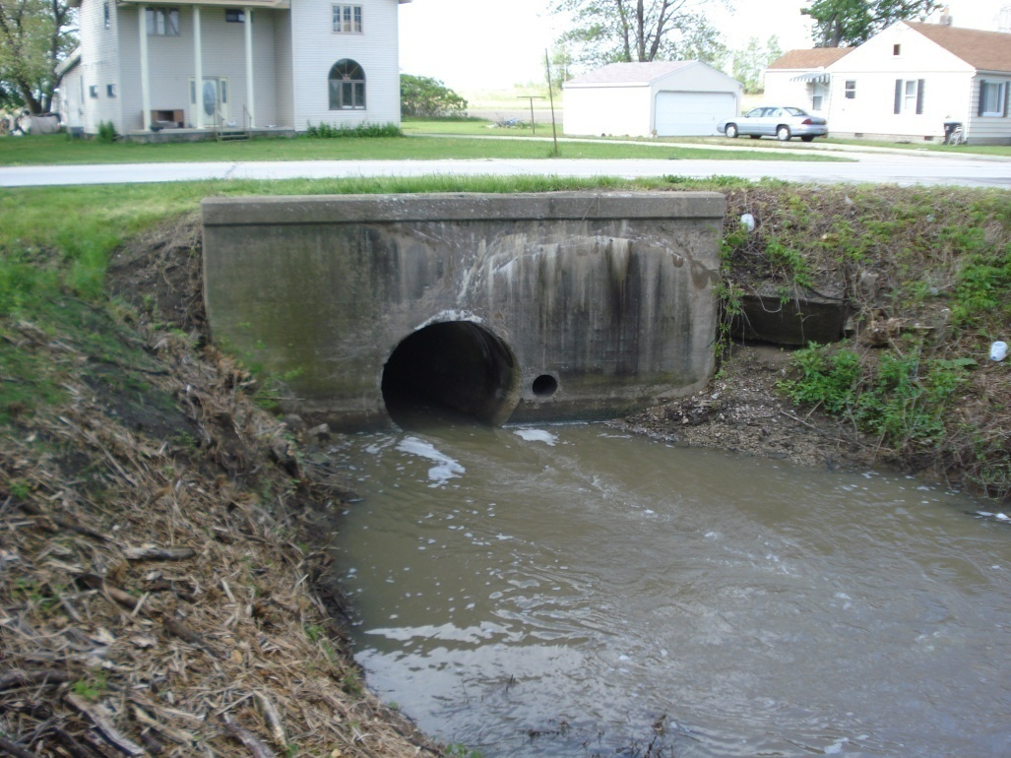
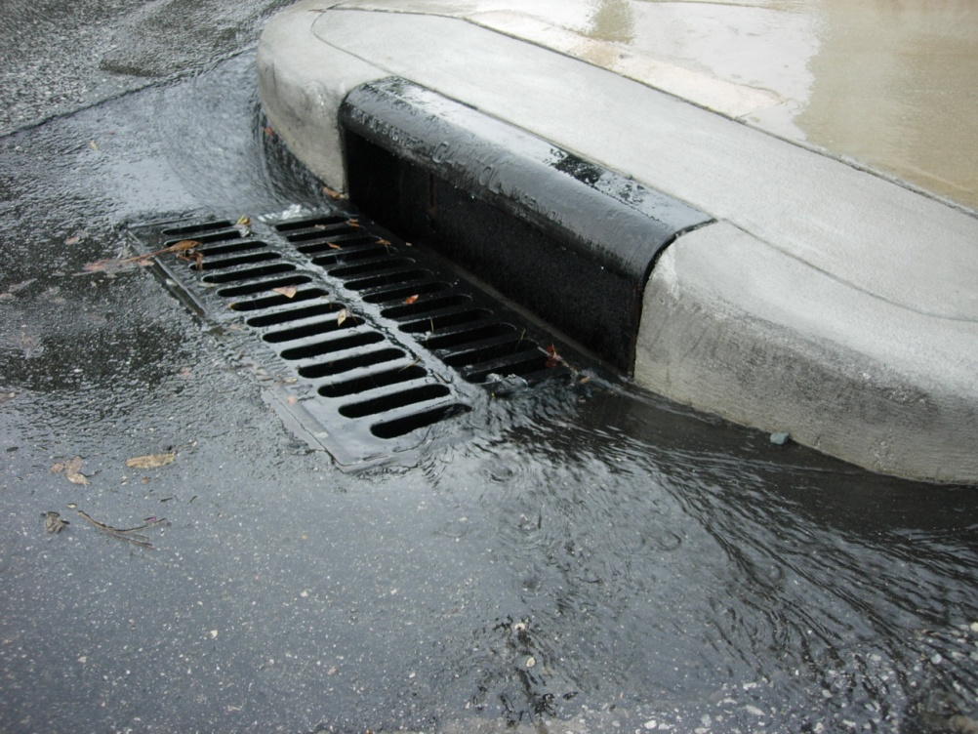
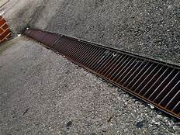
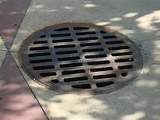
What are these called?

Slide 2
STORM DRAINS!

Slide 3
Many storm drains lead into our rivers and lakes, where most people get their drinking water
The water flowing through the drains is not filtered or processed

Slide 6
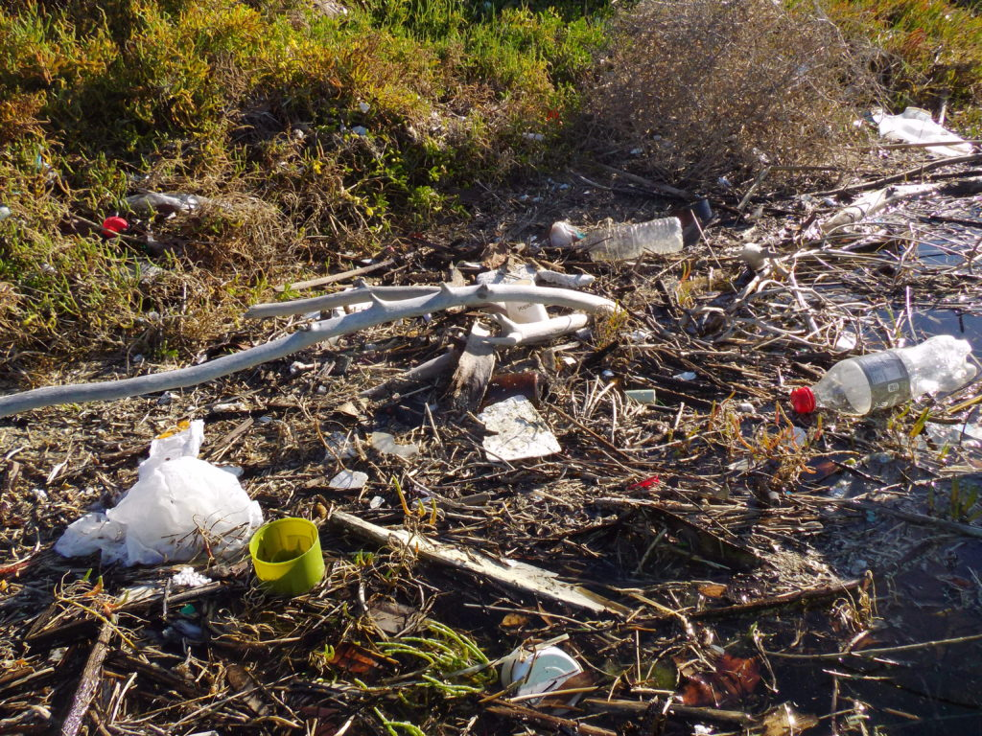
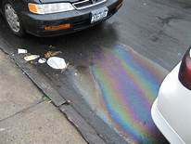
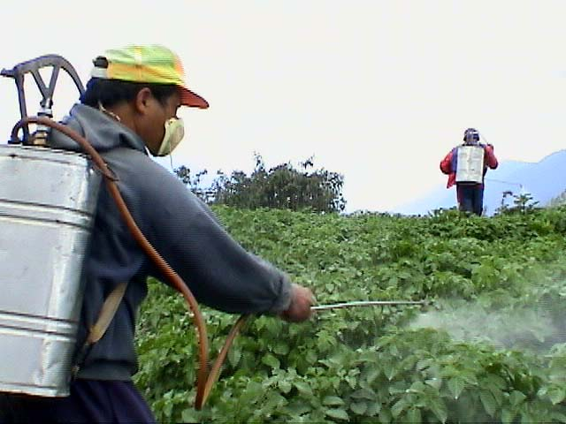
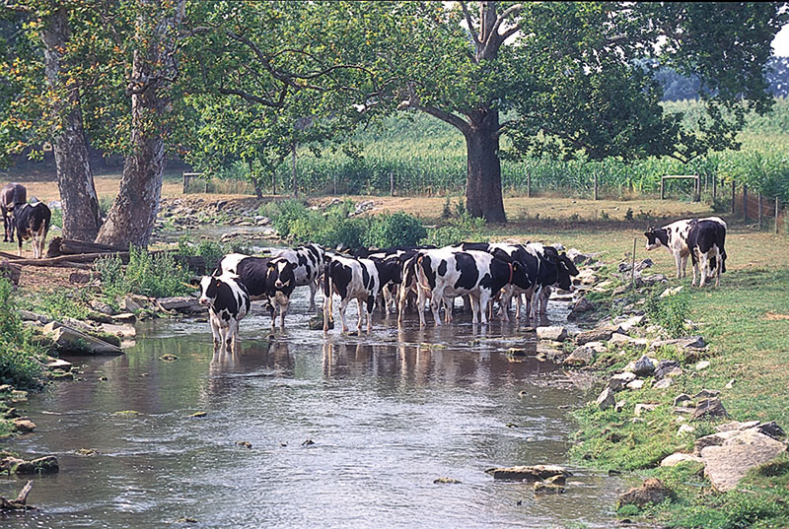
Types of pollution that impact waterways through storm drains

Slide 7
Point-source pollution is easy to identify, it comes from a single place. Nonpoint-source pollution is harder to identify and harder to address. It is pollution that comes from many places, all at once.
Almost everything humans do, from growing food to manufacturing products to generating electricity, has the potential to release pollution into our waterways. People who are responsible for protecting the environment identify two main categories of pollution: point-source and nonpoint-source pollution.

Slide 8
Point Source Pollution
This type of pollution can be traced to a source such as sewage treatment plants; oil refineries; paper and pulp mills; chemical, golf courses, automobiles, electronics manufacturers, farms and factories.
The type of pollutants can include wastes, soils, rocks, chemicals, bacteria, suspended solids, heavy metals, pesticides, and more.

Slide 9
Nonpoint Source Pollution
This type of pollution can’t be traced to a specific place or activity. It is produced from many sources and more difficult to stop.
The type of pollutants can include:
Fertilizers, herbicides and insecticides from agricultural lands and residential areas.
Oil, grease and toxic chemicals from urban runoff and energy production.
Sediment from improperly managed construction sites, crop and forest lands, and eroding streambanks.

Slide 11
How to mark a storm drain
Step 1: Determine the location where you will paint the stenciled message. Public Works wants the stenciling to be on the storm drain structure and visible, similar to where the blue box is in the image to the right.
Step 2: Use the wire brush to remove any dirt or scum from the desired stenciling spot by scrubbing briskly.

Slide 12
How to mark a storm drain – continued
Step 3: Use the whisk broom to sweep away any other loose dirt or debris.
Step 4: Place the stencil on the prepared area. Secure the stencil in place using the duct tape provided. Be careful not to move the stencil once in place.

Slide 13
How to mark a storm drain – continued
Step 5: Using the cardboard provided by your group, create a barrier around the stencil to prevent over-spray.
Step 6: Wear disposable gloves provided. Shake the spray paint can for at least one minute after rattle is heard (and occasionally during use). Invert can and hold approximately 5 inches above surface to be marked, pressing sprayhead to the side to begin marking. In a series of wide sweeping motions, spray one line at a time using a side to side motion until letters are uniformly covered. Do not spray too much—paint will run under stencil, making the works unreadable.

Slide 14
How to mark a storm drain – continued
Step 7: When finished, carefully remove the duct tape and lift the stencil up off the street. Do not leave or remove the traffic cones until the paint is completely dry. Use the cloth rag provided to wipe the wet paint off of the stencil, or wait for paint to dry and gently roll the stencils to chip off the paint. Make sure all stenciling kit materials are accounted for and back in the kit.

Slide 15
Other things to remember!
Wear your safety vest the entire time you are at the event
Make sure you have all the right tools
DO NOT stencil near parked cars or other private property that may be damaged by the paint.
Remember, each stenciling group should include a minimum of 3 people. One person to watch traffic and at least two people to stencil.
Once finished, make sure all stenciling kit materials are accounted for and back in the kit.

Slide 16
Have fun and thank you for helping to keep our rivers and streams healthy and clean.

